Slide 1
Session 22 : Android Intent I
Module 4.3 : Android

Slide 2
Learning Objectives
At the end of the session successful participants will be able to
Understand Android Intent
Invoke activities using Intent
Implement Built-in Standard Actions

Slide 3
Android Intents
Android Activities
An Android application could include any number of activities.
An activity uses the setContentView(...) method to expose (usually) a single UI from which a number of actions could be performed.
Activities are independent of each other; however they usually cooperate exchanging data and actions.

Slide 4
Android Intents
Android Activities
An Android application could include any number of activities.
Typically, one of the activities is designated as the first one (main) that should be presented to the user when the application is launched.
Moving from one activity to another is accomplished by asking the current activity to execute an intent.
Activities interact with each other in an asynchronous mode.

Slide 5
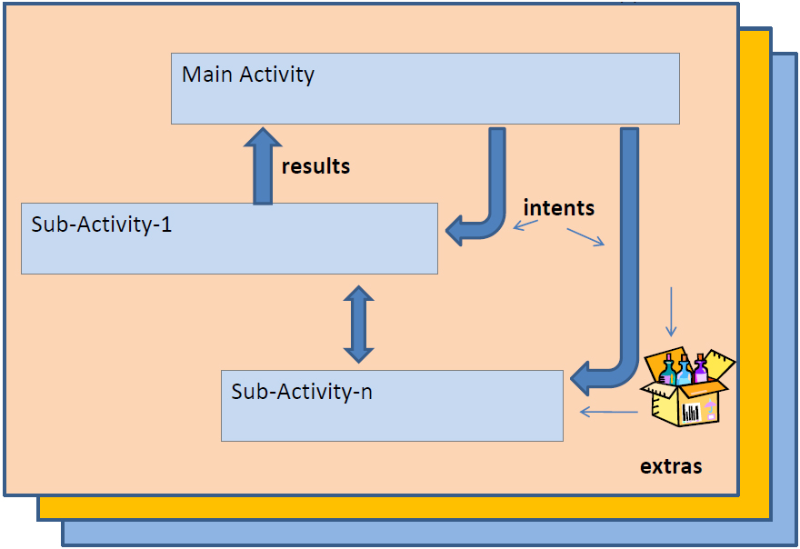
Android Intents
Android Activities
Android Application

Slide 6
Android Intents
Intents
Intents are invoked using the following options
startActivity (intent) | Launches an Activity
sendBroadcast (intent) | Sends an intent to any interested BroadcastReceiver components
startService (intent) or bindService (intent, …) | Communicate with a background Service

Slide 7
Android Intents
Intents
The main arguments of an Intent are:
Action
The built-in action to be performed, such as ACTION_VIEW, ACTION_EDIT, ACTION_MAIN, … or user-created-activity
Data
The primary data to operate on, such as a phone number to be called (expressed as aUri).
Intent: { action + data }
Activity 1
Activity 2
Optional results

Slide 8
Android Intents
Intents
Typically an intent is called as follows:
IntentmyActivity= new Intent(action, data);
startActivity(myActivity);
Built-in or user-created activity
Primary data (as an URI)
tel://
http://
sendto://

Slide 9
Android Intents
Intents
Examples of action/data pairs are:
ACTION_DIAL tel:123
Display the phone dialer with the given number filled in.
ACTION_VIEW http://www.google.com
Show Google page in a browser view. Note how the VIEW action does what is considered the most reasonable thing for a particular URI.

Slide 10
Android Intents
Intents
Examples of action/data pairs are:
ACTION_EDIT content://contacts/people/2
Edit information about the person whose identifier is "2".
ACTION_VIEW content://contacts/people/2
Used to start an activity to display 2-nd person.

Slide 11
Android Intents
Intents
Examples of action/data pairs are:
ACTION_VIEW content://contacts/people/
Display a list of people, which the user can browse through. Selecting a particular person to view would result in a new intent

Slide 12
Android Intents
Built-in Standard Actions
List of standard actions that Intents can use for launching activities (usually through startActivity(Intent).
ACTION_MAIN ACTION_VIEW ACTION_ATTACH_DATA ACTION_EDIT ACTION_PICK ACTION_CHOOSER ACTION_GET_CONTENT ACTION_DIAL ACTION_CALL ACTION_SEND ACTION_SENDTO | ACTION_ANSWER ACTION_INSERT ACTION_DELETE ACTION_RUN ACTION_SYNC ACTION_PICK_ACTIVITY ACTION_SEARCH ACTION_WEB_SEARCH ACTION_FACTORY_TEST

Slide 13
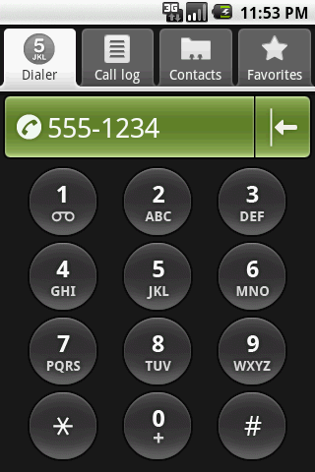
Android Intents
Built-in Standard Actions
Example: Display the phone dialer with the given number filled in.
IntentmyActivity2 = newIntent(Intent.ACTION_DIAL, Uri.parse( "tel:555-1234"));
startActivity(myActivity2);

Slide 14

Android Intents
Intents - Secondary Attributes
In addition to the primary action/data attributes, there are a number of secondary attributes that you can also include with an intent, such as:
Category
Components
Type
Extras
Example: Google search looking for golf clubs
Intentintent= new Intent (Intent.ACTION_WEB_SEARCH); intent.putExtra(SearchManager.QUERY, "straight hitting golf clubs"); startActivity(intent);
Secondary data

Slide 15
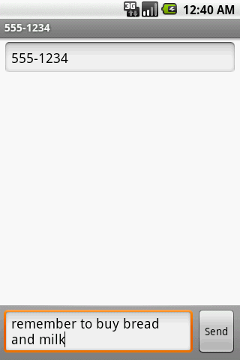
Android Intents
Intents - Secondary Attributes
Example: Sending a text message (using extra attributes)
Intentintent= new Intent( Intent.ACTION_SENDTO, Uri.parse("sms://"));
intent.putExtra("address", "555-1234");
intent.putExtra("sms_body", "remember to buy bread and milk");
startActivity(intent);

Slide 16

Android Intents
Intents - Secondary Attributes
Example: Showing Pictures (using extra attributes)
IntentmyIntent= new Intent();
myIntent.setType("image/pictures/*");
myIntent.setAction(Intent.ACTION_GET_CONTENT);
startActivity(myIntent);

Slide 17
Android Intents
A Complete Example
Activity1 displays an interface to accept a phone number and requests (built-in) Activity2 to make the call.
<?xml version="1.0" encoding="utf-8"?><LinearLayoutxmlns:android="http://schemas.android.com/apk/res/android"android:orientation="vertical"android:layout_width="fill_parent"android:layout_height="fill_parent" ><TextViewandroid:id="@+id/label1"android:layout_width="fill_parent"android:layout_height="wrap_content"android:background="#ff0000cc"android:text="This is Activity1"android:textStyle="bold"android:textSize="20sp" />

Slide 18
Android Intents
A Complete Example
Activity1 displays an interface to accept a phone number and requests (built-in) Activity2 to make the call.
<EditTextandroid:id="@+id/text1"android:layout_width="fill_parent"android:layout_height="54px"android:text="tel:555-1234"android:textSize="18sp" /><Buttonandroid:id="@+id/btnCallActivity2"android:layout_width="149px"android:layout_height="wrap_content"android:text="Make Phone Call"android:textStyle="bold" /></LinearLayout>

Slide 19
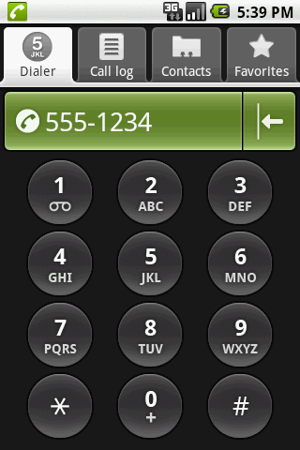
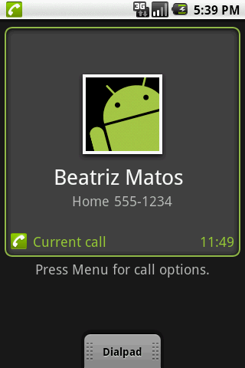
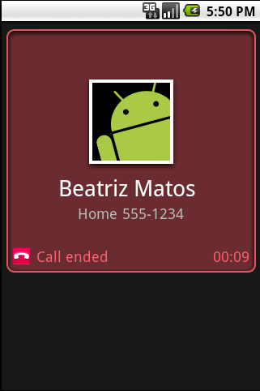
Android Intents
A Complete Example
Activity1 displays an interface to accept a phone number and requests (built-in) Activity2 to make the call.

Slide 20
Android Intents
A Complete Example
Activity1 displays an interface to accept a phone number and requests (built-in) Activity2 to make the call.
//IntentDemo1_Intent: making a phone call
package cis493.intents;
import android.app.Activity;
import android.content.Intent;
import android.net.Uri;
import android.os.Bundle;
import android.view.View;
import android.view.View.OnClickListener;
import android.widget.*;
public class IntentDemo1 extendsActivity {
TextViewlabel1;

Slide 21
Android Intents
A Complete Example
Activity1 displays an interface to accept a phone number and requests (built-in) Activity2 to make the call.
EditTexttext1;
Button btnCallActivity2;
@Override
public void onCreate(Bundle savedInstanceState) {
super.onCreate(savedInstanceState);
try{
setContentView(R.layout.main);
label1= (TextView)findViewById(R.id.label1);
text1= (EditText)findViewById(R.id.text1);
btnCallActivity2= (Button)findViewById(R.id.btnCallActivity2);
btnCallActivity2.setOnClickListener(newClickHandler());

Slide 22
Android Intents
A Complete Example
Activity1 displays an interface to accept a phone number and requests (built-in) Activity2 to make the call.
}
catch(Exception e) {
Toast.makeText(getBaseContext(), e.getMessage(), Toast.LENGTH_LONG).show();
}
}//onCreate
private class ClickHandlerimplementsOnClickListener{
@Override
publicvoidonClick(View v) {
try{
// myActivity2 places a phone call
// for ACTION_CALL or ACTION_DIAL

Slide 23
Android Intents
A Complete Example
Activity1 displays an interface to accept a phone number and requests (built-in) Activity2 to make the call.
// use 'tel:' formatted data: "tel:555-1234"
// for ACTION_VIEW use data: "http://www.youtube.com"
// (you also need INTERNET permission -see Manifest)
String myData= text1.getText().toString();
Intent myActivity2 = newIntent(Intent.ACTION_DIAL, Uri.parse(myData));
startActivity(myActivity2);
}
catch(Exception e) {
Toast.makeText(getBaseContext(), e.getMessage(), Toast.LENGTH_LONG).show();
}

Slide 24
Android Intents
A Complete Example
Activity1 displays an interface to accept a phone number and requests (built-in) Activity2 to make the call.
}//onClick
}//ClickHandler
}//IntentDemo1
<?xml version="1.0" encoding="utf-8"?>
<manifest xmlns:android="http://schemas.android.com/apk/res/android"
package="cis493.intents"
android:versionCode="1"
android:versionName="1.0">
<application android:icon="@drawable/icon" android:label="@string/app_name">
<activityandroid:name=".IntentDemo1“

Slide 25
Android Intents
A Complete Example
Activity1 displays an interface to accept a phone number and requests (built-in) Activity2 to make the call.
android:label="@string/app_name">
<intent-filter>
<action android:name="android.intent.action.MAIN" />
<category android:name="android.intent.category.LAUNCHER" />
</intent-filter>
</activity>
</application>
<uses-sdkandroid:minSdkVersion="3" />
</manifest>

Slide 26
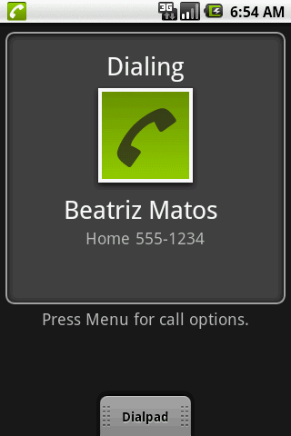
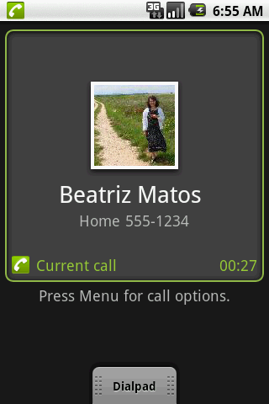
Android Intents
Examples: Using Standard Actions
Call Immediately: Modify the complete example1 replacing the method ‘ClickHandler’ with the following code
String myData= "tel:555-1234";
Intent myActivity2 = newIntent(Intent.ACTION_CALL, Uri.parse(myData));
startActivity(myActivity2);
Note Permission: <uses-permission android:name="android.permission.CALL_PHONE" />

Slide 27
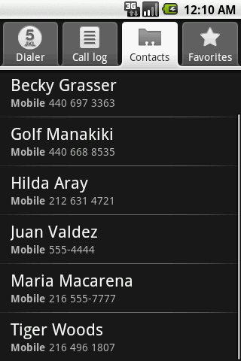
Android Intents
Examples: Using Standard Actions
Show all your Contacts: Modify the complete example1 replacing the method ‘ClickHandler’ with the following code
String myData= "content://contacts/people/";
Intent myActivity2 = newIntent(Intent.ACTION_VIEW, Uri.parse(myData));
startActivity(myActivity2);

Slide 28
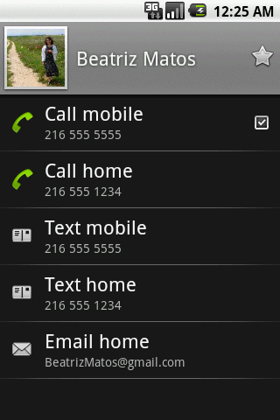
Android Intents
Examples: Using Standard Actions
Show a Particular Contact (ID = 2): Modify the complete example1 replacing the method ‘ClickHandler’ with the following code
String myData= "content://contacts/people/2";
Intent myActivity2 = newIntent(Intent.ACTION_VIEW, Uri.parse(myData));
startActivity(myActivity2);

Slide 29
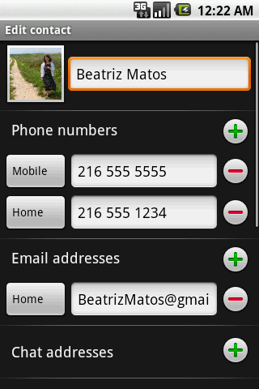
Android Intents
Examples: Using Standard Actions
Edit a Particular Contact (ID = 2): Modify the complete example1 replacing the method ‘ClickHandler’ with the following code
String myData= "content://contacts/people/2";
Intent myActivity2 = newIntent(Intent.ACTION_EDIT, Uri.parse(myData));
startActivity(myActivity2);

Slide 30

Android Intents
Examples: Using Standard Actions
View a Webpage: Modify the complete example1 replacing the method ‘ClickHandler’ with the following code
String myData= "http://www.youTube.com";
Intent myActivity2 = newIntent(Intent.ACTION_VIEW, Uri.parse(myData));
startActivity(myActivity2);
Caution: Add to the Manifest a request to use the Internet:
<uses-permission android:name ="android.permission.INTERNET" />

Slide 31
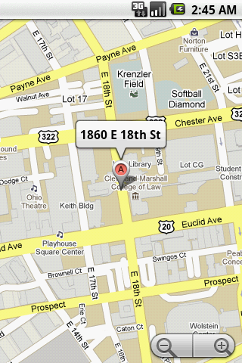
Android Intents
Examples: Using Standard Actions
Geo Mapping an Address: Provide a geoCode expression holding a street address (or place, such as ‘golden gate ca’) Replace spaces with ‘+’.
String geoCode=
"geo:0,0?q=1860+east+18th+street+cleveland+oh";
Intent intent= newIntent(Intent.ACTION_VIEW, Uri.parse(geoCode));
startActivity(intent);
Modify the Manifest adding the following requests:
<uses-permission android:name="android.permission.ACCESS_COARSE_LOCATION"/>
<uses-permission ndroid:name="android.permission.INTERNET"/>

Slide 32
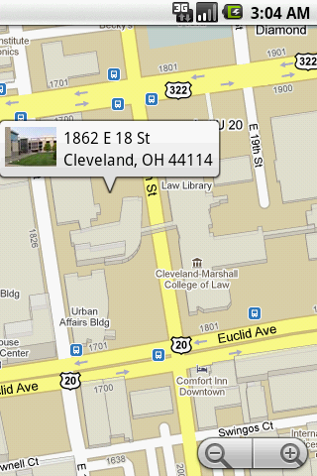
Android Intents
Examples: Using Standard Actions
Geo Mapping Coordinates (latitude, longitude): Provide a geoCode holding latitude and longitude (also an addittional zoom ‘?z=xx’ with xx in range 1..23)
String geoCode= "geo:41.5020952,-81.6789717";
Intent intent= newIntent(Intent.ACTION_VIEW, Uri.parse(geoCode));
startActivity(intent);
Modify the Manifest adding the following requests:
<uses-permission android:name="android.permission.ACCESS_COARSE_LOCATION"/>
<uses-permission android:name="android.permission.INTERNET"/>

Slide 33
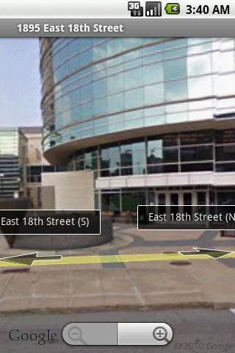
Android Intents
Examples: Using Standard Actions
Geo Mapping -Google StreetView: geoCodeUri structure:
google.streetview:cbll=lat,lng&cbp=1,yaw,,pitch,zoom&mz=mapZoom
String geoCode=
"google.streetview:cbll=41.5020952,-81.6789717&cbp=1,270,,45,1&mz=1";
Intent intent= newIntent(Intent.ACTION_VIEW, Uri.parse(geoCode));
startActivity(intent);
Modify the Manifest adding the following requests:
<uses-permission android:name="android.permission.ACCESS_COARSE_LOCATION"/>
<uses-permission android:name="android.permission.INTERNET"/>

Slide 34
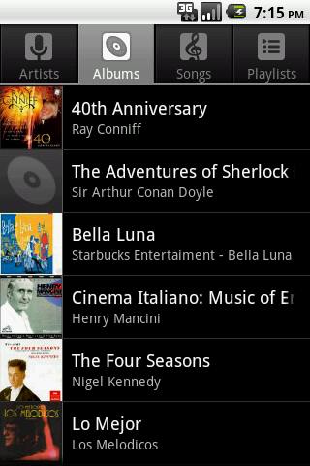
Android Intents
Examples: Using Standard Actions
Launching the Music Player
//launch music player
Intent myActivity2 = newIntent("android.intent.action.MUSIC_PLAYER");
startActivity(myActivity2);

Slide 35
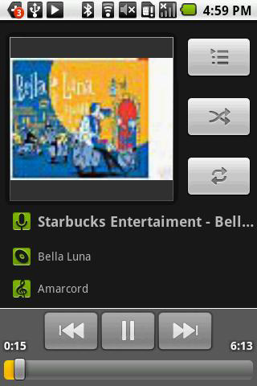
Android Intents
Examples: Using Standard Actions
Playing a song stored in the SD card
// play song "amarcord.mp3" saved in the SD
Intent myActivity2 =
newIntent(android.content.Intent.ACTION_VIEW);
Uri data = Uri.parse("file:///sdcard/amarcord.mp3");
String type = "audio/mp3";
myActivity2.setDataAndType(data, type);
startActivity(myActivity2);

Slide 36
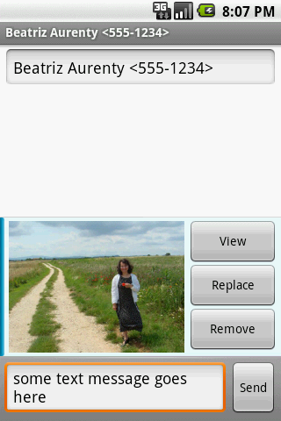
Android Intents
Examples: Using Standard Actions
Sending MMS: Add picture #1 from SD to MMS
//send mms attach picture #1 to it
Uri uri= Uri.parse("content://media/external/images/media/1");
myActivity2 = newIntent(Intent.ACTION_SEND);
myActivity2.putExtra("address", "555-1234");
myActivity2.putExtra("sms_body", "some text message goes here");
myActivity2.putExtra(Intent.EXTRA_STREAM, uri);
myActivity2.setType("image/png");
startActivity(myActivity2);

Slide 37
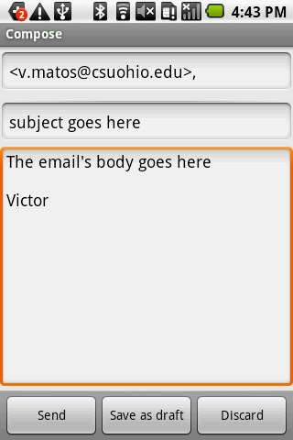
Android Intents
Examples: Using Standard Actions
Sending Email
// send email
Uri uri= Uri.parse("mailto:v.matos@csuohio.edu");
Intent myActivity2 = newIntent(Intent.ACTION_SENDTO, uri);
// you may skip the next two pieces [subject/text]
myActivity2.putExtra(Intent.EXTRA_SUBJECT, "subject goes here");
myActivity2.putExtra(Intent.EXTRA_TEXT,
"The email's body goes here");
startActivity(myActivity2);

Slide 38
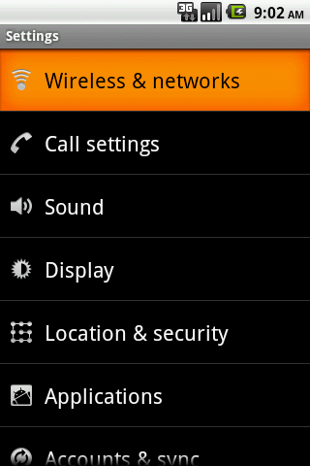
Android Intents
Examples: Using Standard Actions
Setting System
Intentintent= newIntent(
android.provider.Settings.ACTION_SETTINGS);
startActivity(intent);

Slide 39
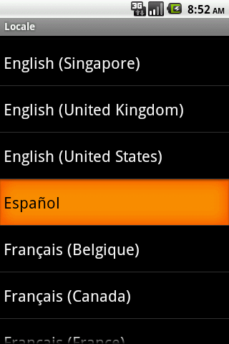
Android Intents
Examples: Using Standard Actions
Setting System Locale: Language & Keyboard
Intent intent= newIntent(
android.provider.Settings.ACTION_LOCALE_SETTINGS);
startActivity(intent);

Slide 40
Android Intents
Starting Activities and Getting Results
The startActivity(Intent)method is used to start a new activity, which will be placed at the top of the activity stack.
Sometimes you want to get a result back from the called sub-activity when it ends.
Note: You may start an activity that let the user pick a person from a list of contacts; when it ends, it returns the person that was selected.

Slide 41
Android Intents
Starting Activities and Getting Results
In order to get results back from the called activity we use the method where the second (requestCodeID) parameter identifies the call.
startActivityForResult( Intent, requestCodeID)
The result sent by the sub-activity could be picked up through the asynchronous method
onActivityResult( requestCodeID, resultCode, Intent )

Slide 42
Android Intents
Starting Activities and Getting Results
Before an activity exits, it can call setResult(resultCode) to return a termination signal back to its parent.
Always supply a result code, which can be the standard results Activity.RESULT_CANCELED, Activity.RESULT_OK, or any custom values.

Slide 43
Android Intents
Starting Activities and Getting Results
All of this information can be capture back on the parent's onActivityResult(intrequestCodeID, intresultCode, Intent data) along with the integer identifier it originally supplied.
If a child activity fails for any reason (such as crashing), the parent activity will receive a result with the code RESULT_CANCELED.

Slide 44
Android Intents
Starting Activities and Getting Results
Intent: {action +
data + requestCodeID}
Activity – 1
startActivityForResult
…
…
onActivityResult()
…
…
Activity – 2
onResult()
…
…
requestCodeID
resultCode
optional data

Slide 45
Android Intents
Example: Let’s Play Golf – Call For A Tea Time
Show all contacts and pick a particular one (Intent.ACTION_PICK).
For a successful interaction the main-activity accepts the returned URI identifying the person we want to call (content://contacts/people/n).
‘Nicely’ show the selected contact’s entry allowing calling, texting, emailing actions (Intent.ACTION_VIEW).

Slide 46
Android Intents
Example: Let’s Play Golf – Call For A Tea Time
User’s Main Activity
Built-in
Activity – 2
(show contact list)
Intent.ACTION_PICK
Contact’s Uri
Built-in
Activity – 3
(show selected contact)
Call
Send text message
Send email
Intent.ACTION_VIEW

Slide 47
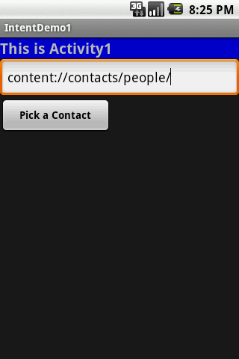
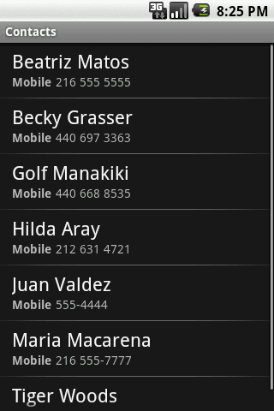
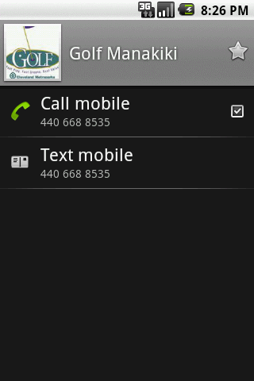
Android Intents
Example: Let’s Play Golf – Call For A Tea Time
Cont…
Main Activity
Intent.ACTION_PICK
Intent.ACTION_VIEW

Slide 48
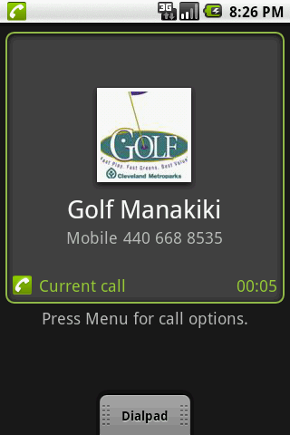
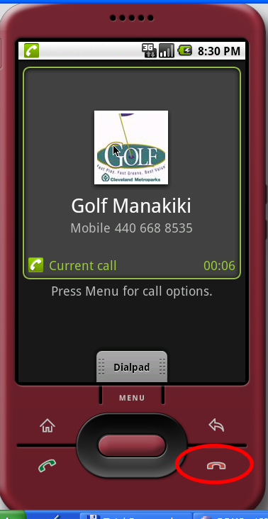
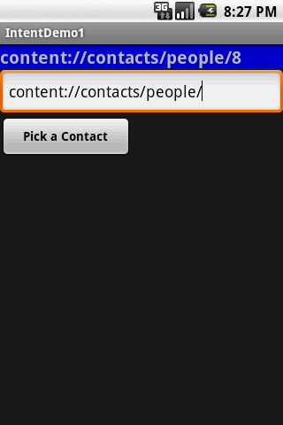
Android Intents
Example: Let’s Play Golf – Call For A Tea Time
Place the call
Terminate the call
Selected Contact’s URL

Slide 49
Android Intents
Example: Calling A Sub-activity, Receiving Results
//IntentDemo2_Intent: making a phone call
//receiving results from a sub-activity
package cis493.intents;
import android.app.Activity;
import android.content.Intent;
import android.net.Uri;
import android.os.Bundle;
import android.view.View;
import android.view.View.OnClickListener;
import android.widget.*;
public class IntentDemo2 extendsActivity {
TextViewlabel1;
EditTexttext1;
Button btnCallActivity2;

Slide 50
Android Intents
Example: Calling A Sub-activity, Receiving Results
@Override
public void onCreate(Bundle savedInstanceState) {
super.onCreate(savedInstanceState);
try{
setContentView(R.layout.main);
label1= (TextView)findViewById(R.id.label1);
text1= (EditText)findViewById(R.id.text1);
btnCallActivity2= (Button)findViewById(R.id.btnPickContact);
btnCallActivity2.setOnClickListener(newClickHandler());
}
catch(Exception e) {
Toast.makeText(getBaseContext(),
e.getMessage(), Toast.LENGTH_LONG).show();
}}//onCreate

Slide 51
Android Intents
Example: Calling A Sub-activity, Receiving Results
private class ClickHandlerimplementsOnClickListener{
@Override
publicvoidonClick(View v) {
try{
// myDatarefer to: content://contacts/people/
String myData= text1.getText().toString();
//you may also try ACTION_VIEW instead
Intent myActivity2 = newIntent(Intent.ACTION_PICK,
Uri.parse(myData));
// start myActivity2.
// Tell it that our requestCodeID(or nickname) is 222
startActivityForResult(myActivity2, 222);
// Toast.makeText(getApplicationContext(),
// "I can't wait for you", 1).show();

Slide 52
Android Intents
Example: Calling A Sub-activity, Receiving Results
}
catch(Exception e) {
label1.setText(e.getMessage());
}
}//onClick
}//ClickHandler
@Override
protected void onActivityResult(intrequestCode,
intresultCode,
Intent data) {
super.onActivityResult(requestCode, resultCode, data);
try{
// use requestCodeto find out who is talking back to us
switch(requestCode){

Slide 53
Android Intents
Example: Calling A Sub-activity, Receiving Results
case(222): {
// 222 is our friendly contact-picker activity
if(resultCode== Activity.RESULT_OK) {
String selectedContact= data.getDataString();
// it will return an URI that looks like:
// content://contacts/people/n
// where n is the selected contacts' ID
label1.setText(selectedContact.toString());
//show a 'nice' screen with the selected contact
Intent myAct3 = newIntent (Intent.ACTION_VIEW,
Uri.parse(selectedContact));
startActivity(myAct3);
}

Slide 54
Android Intents
Example: Calling A Sub-activity, Receiving Results
else{
//user pressed the BACK button
label1.setText("Selection CANCELLED "
+ requestCode+ " "+ resultCode);
}
break;
}
}//switch
}
catch(Exception e) {
Toast.makeText(getBaseContext(), e.getMessage(), Toast.LENGTH_LONG).show();
}}// onActivityResult
}//IntentDemo2

Slide 55
Android Intents
Example: Calling A Sub-activity, Receiving Results
<?xml version="1.0" encoding="utf-8"?>
<LinearLayoutxmlns:android="http://schemas.android.com/apk/res/android"
android:orientation="vertical"
android:layout_width="fill_parent"
android:layout_height="fill_parent“ >
<TextView
android:id="@+id/label1"
android:layout_width="fill_parent"
android:layout_height="wrap_content"
android:background="#ff0000cc"
android:text="This is Activity1"
android:textStyle="bold"
android:textSize="20sp“/>

Slide 56
Android Intents
Example: Calling A Sub-activity, Receiving Results
<EditText
android:id="@+id/text1"
android:layout_width="fill_parent"
android:layout_height="54px"
android:text="content://contacts/people/”android:textSize="18sp” />
<Button
android:id="@+id/btnPickContact"
android:layout_width="149px"
android:layout_height="wrap_content"
android:text="Pick a Contact"
android:textStyle="bold“ />
</LinearLayout>

Slide 57
Android Intents
Example: Showing Pictures And Video - Calling A Sub-activity, Receiving Results
private void showSoundTracks() {
Intent myIntent= newIntent();
myIntent.setType("video/*, images/*");
myIntent.setAction(Intent.ACTION_GET_CONTENT);
startActivityForResult(myIntent, 0);
}//showSoundTracks
@Override
protected void onActivityResult(intrequestCode, intresultCode, Intent intent) {
super.onActivityResult(requestCode, resultCode, intent);
if((requestCode== 0) && (resultCode== Activity.RESULT_OK)) {
String selectedImage= intent.getDataString();
Toast.makeText(this, selectedImage, 1).show();

Slide 58

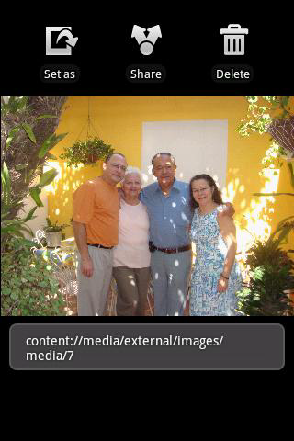
Android Intents
Example: Showing Pictures And Video - Calling A Sub-activity, Receiving Results
// show a 'nice' screen with the selected image
Intent myAct3 = newIntent(Intent.ACTION_VIEW, Uri.parse(selectedImage));
startActivity(myAct3);}}//onActivityResult

Slide 59
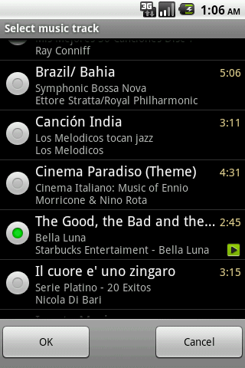
Android Intents
Example: Showing Pictures And Video - Calling A Sub-activity, Receiving Results
private void showSoundTracks() {
Intent myIntent= newIntent();
myIntent.setType("audio/mp3");
myIntent.setAction(Intent.ACTION_GET_CONTENT);
startActivityForResult(myIntent, 0);
}//showSoundTracks
The returned string value is similar to the following “content://media/external/audio/media/14” ACTION_VIEW on that Uri would produce a result similar to the image on the right

Slide 60
Android Intents
Appendix
Built-in Standard BroadcastActions
List of standard actions that Intents can use for receiving broadcasts (usually through registerReceiver(BroadcastReceiver, IntentFilter) or a <receiver> tag in a manifest).
ACTION_TIME_TICK ACTION_TIME_CHANGED ACTION_TIMEZONE_CHANGED ACTION_BOOT_COMPLETED ACTION_PACKAGE_ADDED | ACTION_PACKAGE_CHANGED ACTION_PACKAGE_REMOVED ACTION_UID_REMOVED ACTION_BATTERY_CHANGED

Slide 61
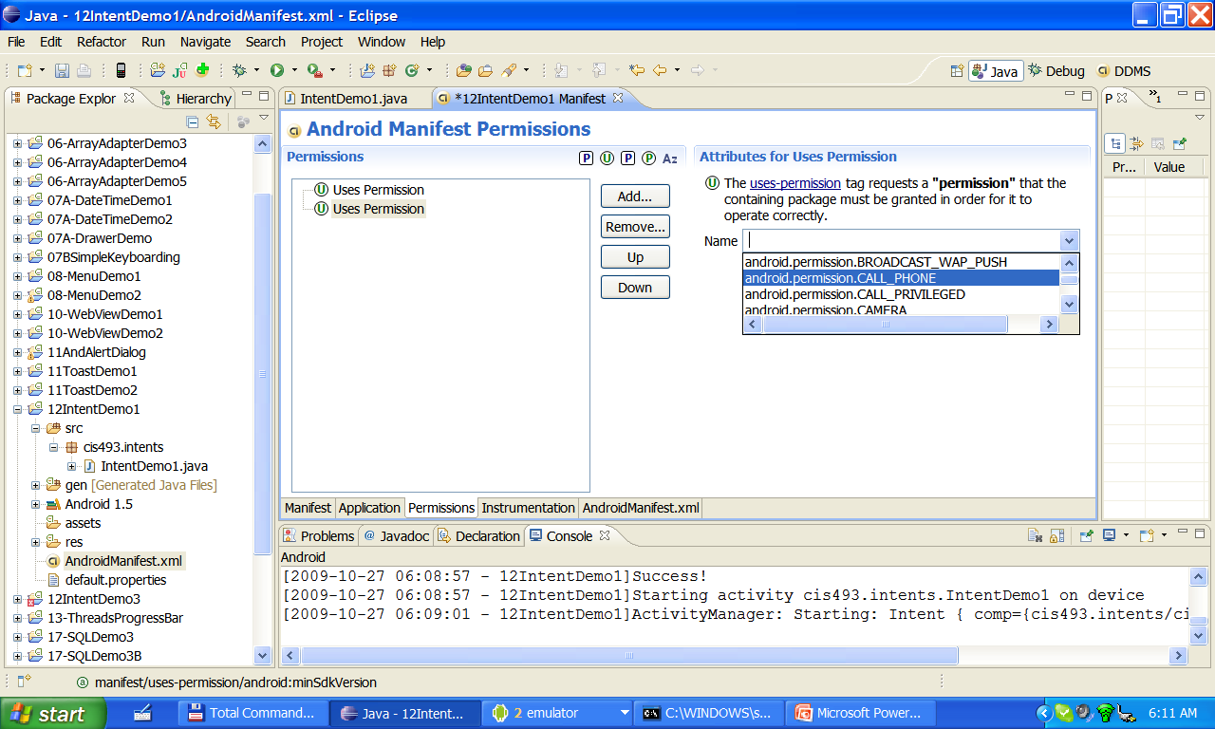
Android Intents
Appendix
Getting Permissions

